Slide 1
Functions

Slide 2
Program routines
In order to manage the complexity of a large problem, it is broken down into smaller subproblems.
Each subproblem can be focused on and solved separately.
Programs are divided into manageable pieces called program routines (or simply routines).
It is a form of abstraction
Reusability
Python’s built-in functions: len, range etc.

Slide 3
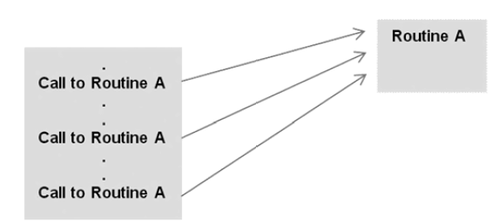
Program routines
A routine is a named group of instructions performing some task.
A routine can be invoked ( called ) as many times as needed in a given program.
When a routine terminates, execution automatically returns to the point from which it was called.

Slide 4
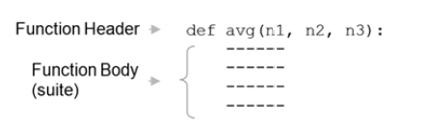
Functions
A block of organized and reusable program code that performs a single, specific, and well-defined task.
Define new functions:
A function header starts with the keyword def, followed by an identifier (avg), which is the function’s name.
list of identifiers (n1, n2, n3) called formal parameters.

Slide 5
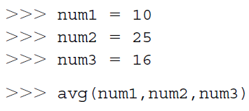
Functions
The number of items in a parameter list indicates the number of values that must be passed to the function, called actual arguments (or “arguments”).
Functions are generally defined at the top of a program.
Every function must be defined before it is called.

Slide 6
Need of Functions
Readability - The program is better organized and easy to understand.
Reduces code length - As the same code is not required to be written at multiple places in a program.
Reusability: As a function can be called from another function or another program. We can reuse or build upon already defined functions and avoid repetitions of writing the same piece of code.

Slide 7
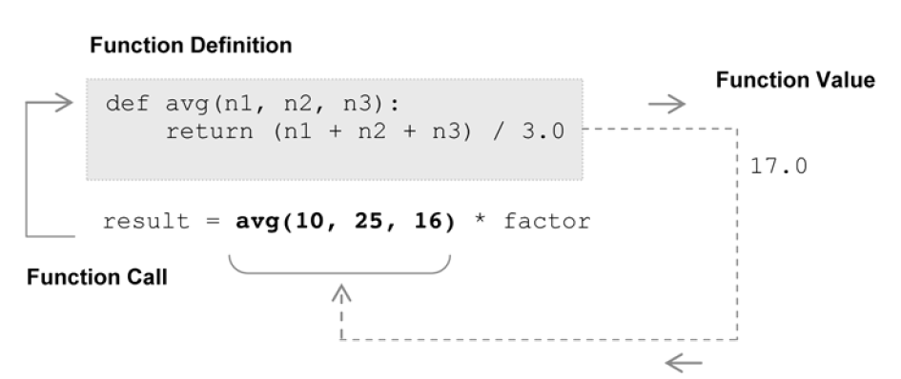
Value-Returning Functions
A value-returning function is a program routine called for its return value.

Slide 8
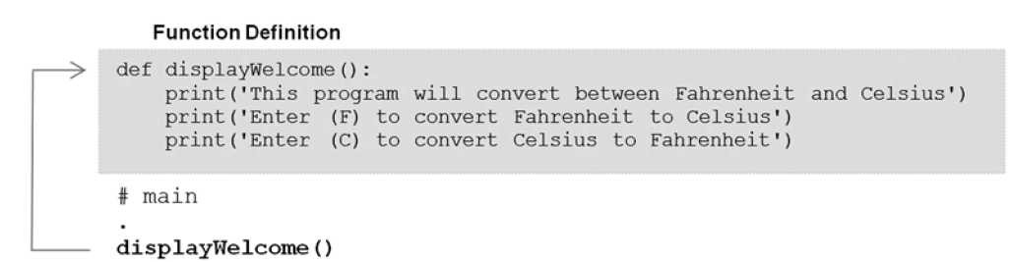
Non-Value-Returning Functions
A non-value-returning function is called not for a returned value, but for its side effects (e.g. displaying output on the screen).
Void functions
The function call is a statement.
Python is technically a value-returning function since any function that does not explicitly return a function value (via a return statement) automatically returns the special value None.

Slide 9
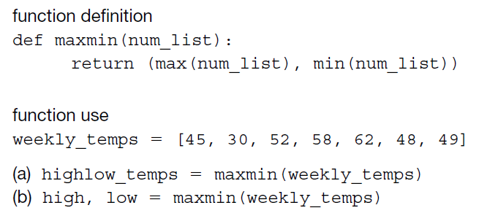
Calling Value-Returning Functions

Slide 10

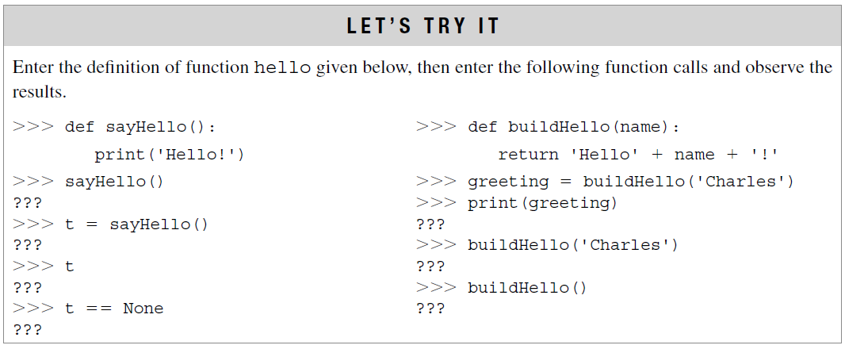
Calling Non-Value-Returning Functions
No returned function values.
These functions can be used anywhere that an executable statement is allowed.

Slide 11
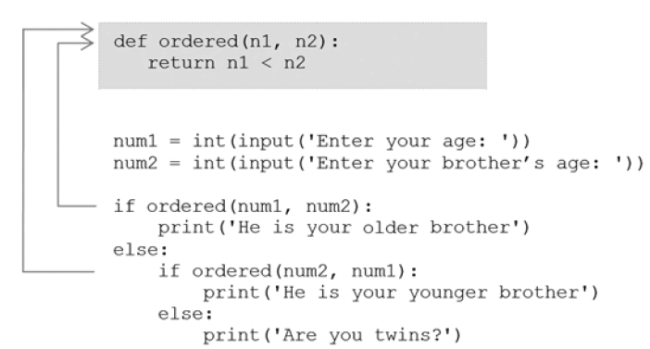
Parameter passing
Actual Arguments vs. Formal Parameters

Slide 12
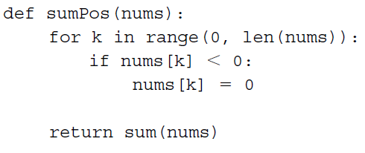

Example
Write a program using user defined function that accepts length and breadth of a rectangle and returns the area and perimeter of the rectangle.
Write a python program using functions to calculate the sum of all positive numbers in a list.

Slide 13
Pass by reference vs value in Python
In languages like C++ or Java, you often hear about pass by value (a copy of data is passed) or pass by reference (the original memory address is passed). Python is a little different. It doesn’t strictly follow either model. Instead, Python uses a "pass by object reference" (also called call by sharing) approach:
When you pass an argument to a function, Python passes the reference (address) of the object, not the actual object or a copy.
Whether the original data changes depends on whether the object is mutable (can be changed in place) or immutable (cannot be changed once created).

Slide 14
Pass by Reference
In pass by reference, the function receives the memory address of the original object, not a copy. This means both the caller and the function share the same object. With mutable types like lists, dicts and sets, any changes made inside the function will reflect outside as well.
def same_list(list):
return list
my_list = ["X"]
same_list(my_list)
print(my_list)

Slide 15
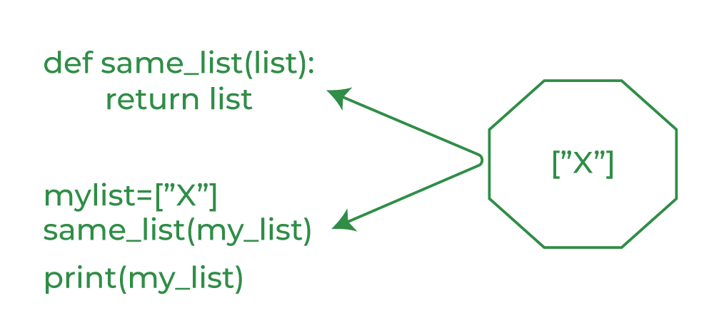

Slide 16
Reassignment (New Object Inside Function)
def set_list(list):
list = ["A"]
return list
my_list = ["X"]
set_list(my_list)
print(my_list)
Output
['X']
Explanation: Function rebinds list to a new list object. This does not affect my_list. list now refers to a new object inside the function and my_list still refers to the original object, which remains unchanged.

Slide 17
In-Place Modification
def add(list):
list.append("B")
return list
my_list = ["X"]
add(my_list)
print(my_list)
Output
['X', 'B']

Slide 18
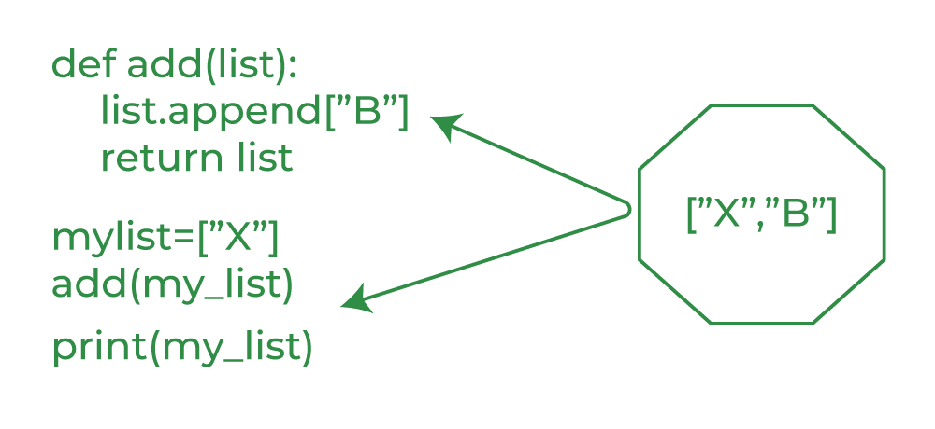
Explanation: Function modifies the list in-place. The change is visible outside. Since list.append("B") changes the contents of the list in place, my_list is also modified.

Slide 19
Pass by Value
In pass-by-value, a copy of the variable is passed, so changes inside the function don't affect the original. While Python doesn't strictly follow this model, immutable objects like int, str, and tuple behave similarly, as changes create new objects rather than modifying the original.

Slide 20
Reassignment with Immutable behavior
def add(list):
list = ["X", "B"] # reassignment, not in-place modification
return list
my_list = ["X"]
add(my_list)
print(my_list)
Output
['X']
Explanation: Inside the function, list is reassigned to a new object. But this does not change my_list outside the function.

Slide 21
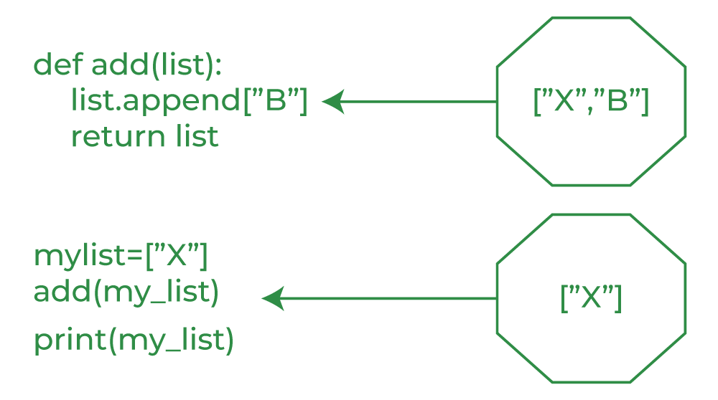
Explanation: Inside the function, list is reassigned to a new object. But this does not change my_list outside the function.

Slide 22
Immutable Integer
def fun(x):
x = x + 10
print("Inside function:", x)
num = 5
fun(num)
print("Outside
function:", num)
Output
Inside function: 15
Outside function: 5
Explanation: Integers are immutable, so modifying x inside the function creates a new object. The original num remains unchanged.

Slide 23
Pass by Reference vs Pass by Value
Aspect | Pass by Reference | Pass by Value
Object Type | Mutable (list, dict, etc.) | Immutable (int, str, etc.)
What is Passed | Reference to object | Reference to object
Can Modify in Function? | Yes (affects original) | No (new object created)
Affects Original? | Yes | No
Typical Behavior | Like aliasing | Like copying

Slide 24
Why Use Functions?​
Reusability – Write once, use multiple times.​
Readability – Code is easier to understand when broken into logical parts.​
Maintainability – Easier to debug and update.​
Testing – Functions can be tested independently.​
Best Practices for Organizing Code with Functions​
One function = one purpose (single responsibility principle).​
Use meaningful names for functions and parameters.​
Keep functions short (ideally under 20 lines).​
Add docstrings to explain what the function does.​
Group related functions into modules (separate .py files) for larger projects.​
​

